Slide 1
Leisurely Growth in the United States
An analysis of the participation of adults in the U.S. in specific leisure activities from 2010 to 2018 inclusive

Slide 2
Data Source
“Adult Participation In Selected Leisure Activities By Frequency: 2018 [As Of Fall]”
Provided by the ProQuest Statistical Abstract of the U.S. – https://statabs-proquest-com.ezproxy.bellevue.edu/sa/docview.html?table-no=1269&acc-no=C7095-1.26&year=2020&z=187A84E2AB438865E1A89BF8BE7405A9A7BC5F95
Due to differences in predicted number of adults in the population, I have chosen to compare the percentage values shown in the data in order to maintain equality between values

Slide 3
Question/Hypothesis
Is there a difference between the number of activities in which adults participate that are done in the local area around their residence as opposed to those that require travel to a specific venue?
H₀: There is no statistically significant difference between the percentage of adults participating in local activities and remote activities
H_{a}: There is a statistically significant difference between the percentage of adults participating in local activities and remote activities (α = 0.05, two-tailed test)

Slide 4
Variables
Activity – list of all activities provided by the survey
Year – stated years from 2010 to 2018
Locality – divided between those activities that can be performed close to home (Local) or those that require travel to a different venue (Remote) [metadata]
Frequency – Specifying if the respondents participated at least once in the activity in the last 12 months and how frequently they participated per week/month (if applicable)
Percentage – percentage of the adult population that participated in that activity and frequency combination

Slide 5
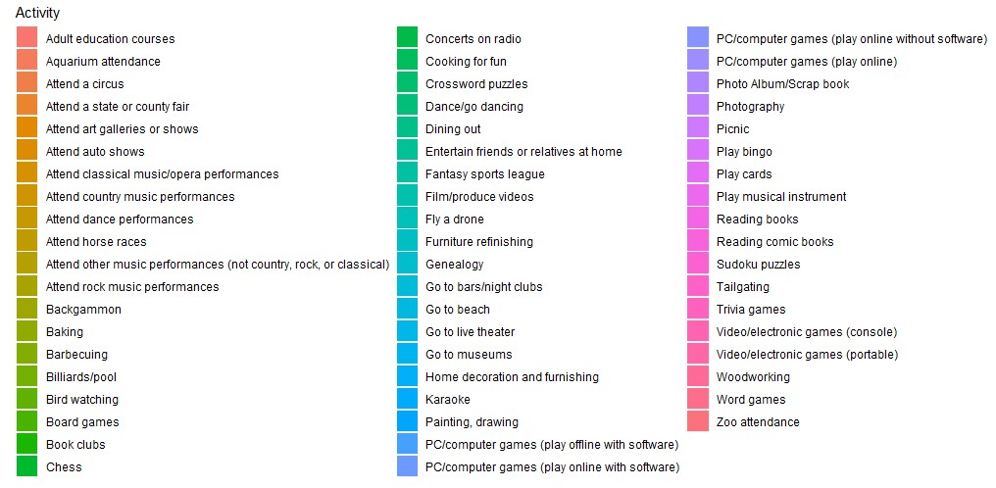
Histogram Legend – Activities

Slide 6
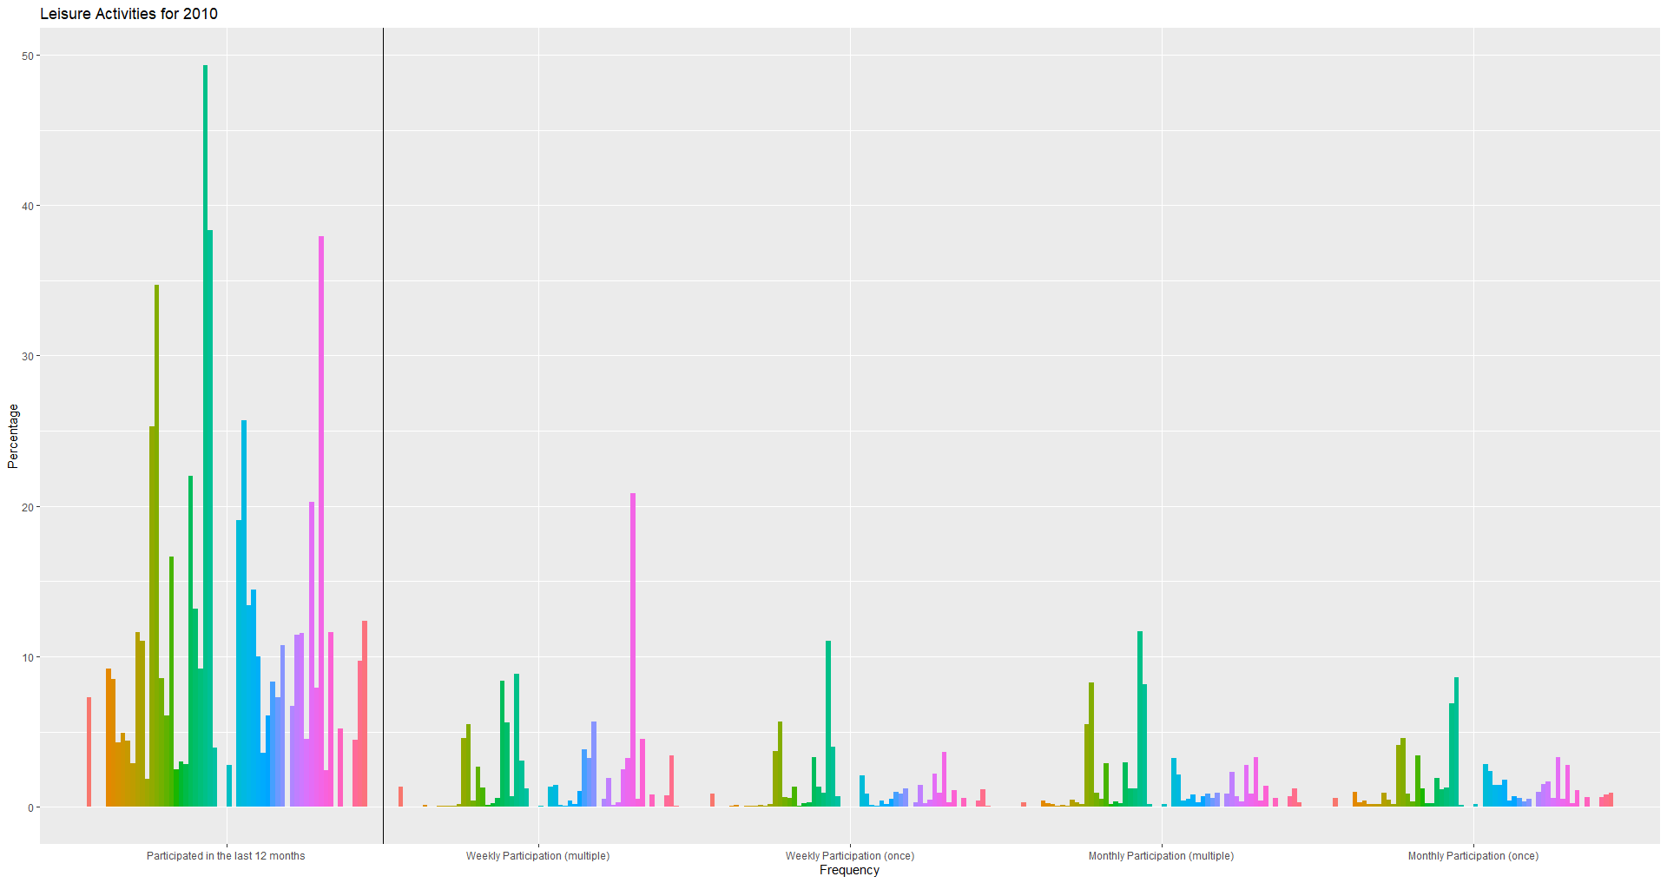

Slide 7
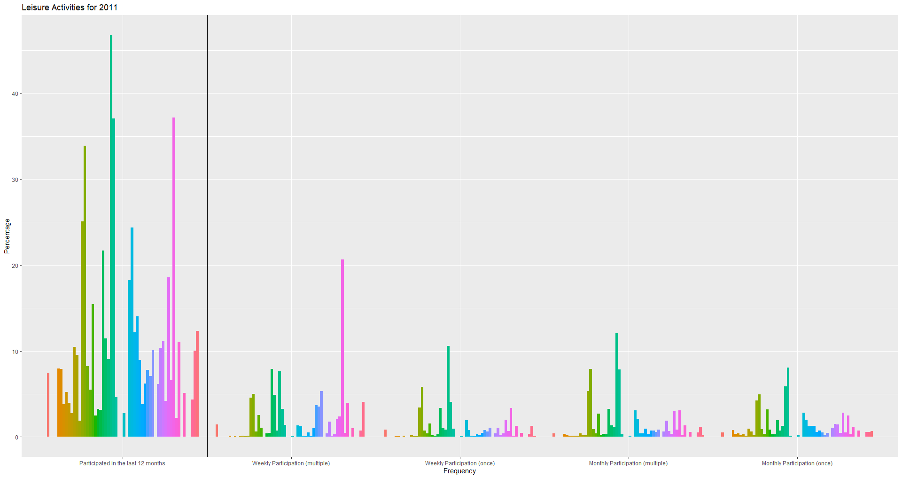

Slide 8
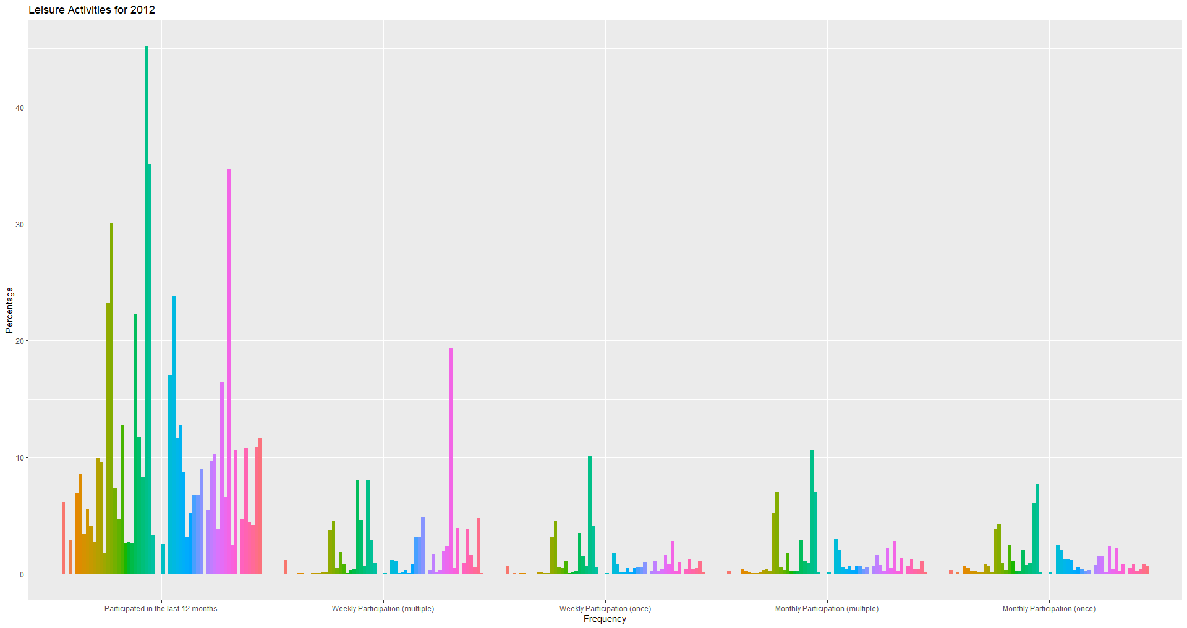

Slide 9


Slide 10


Slide 11
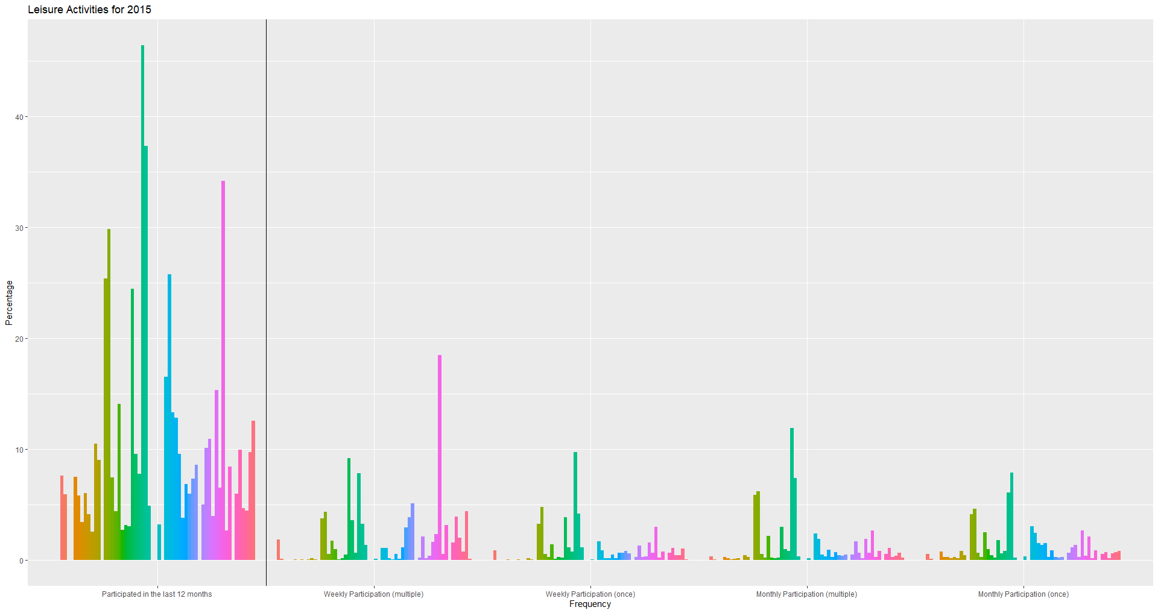

Slide 12
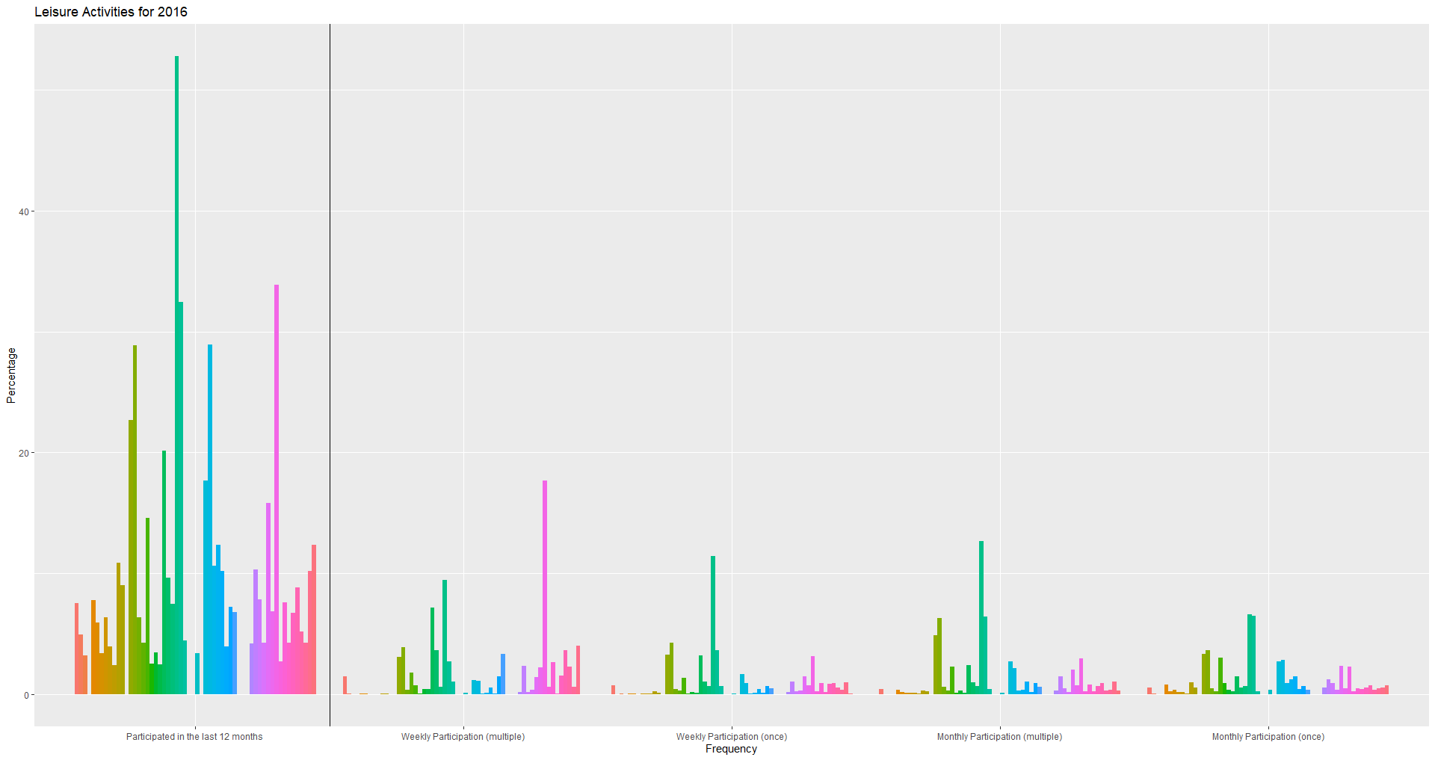

Slide 13


Slide 14


Slide 15
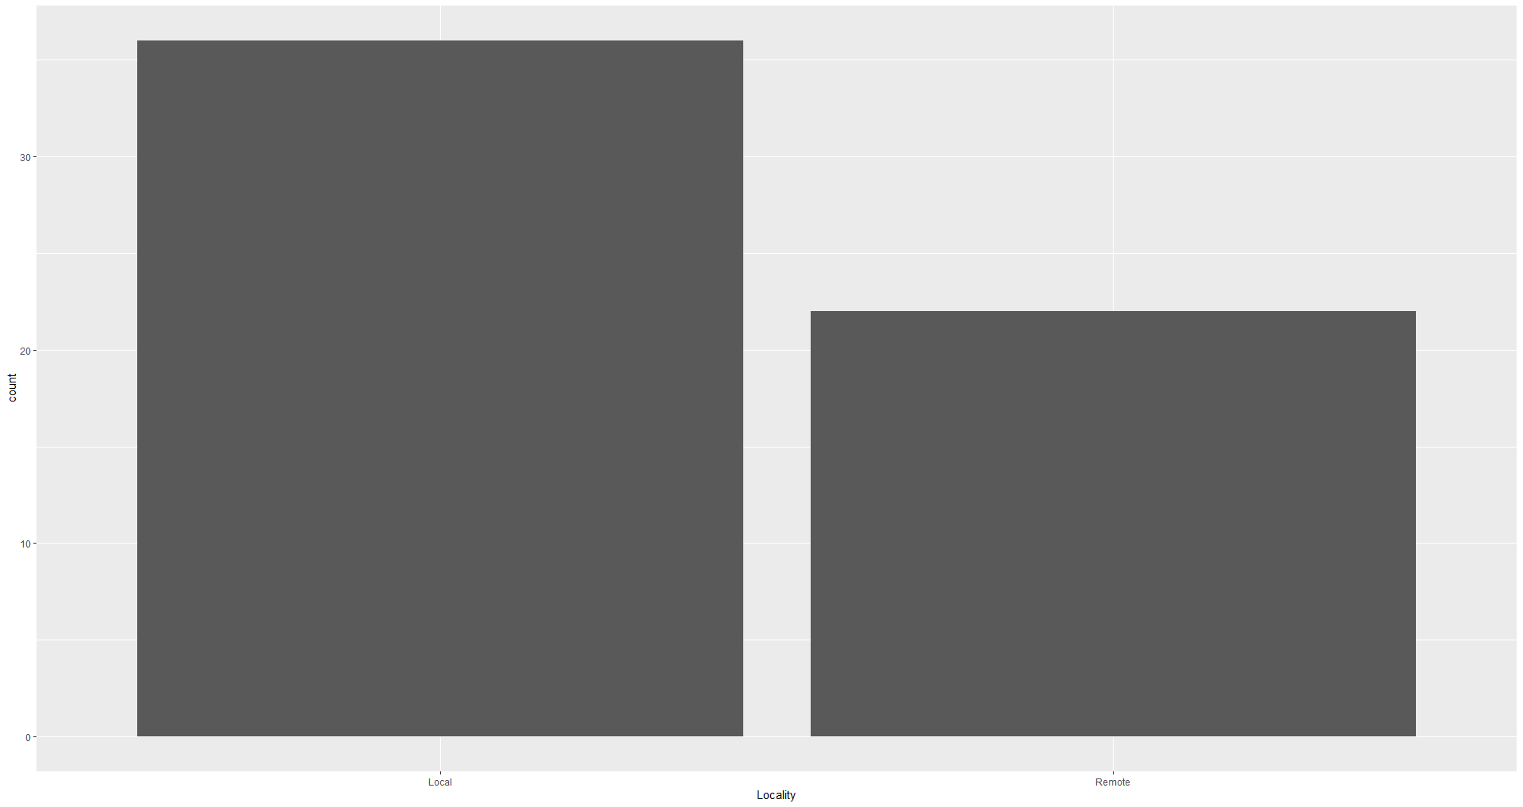
Histogram of Locality

Slide 16
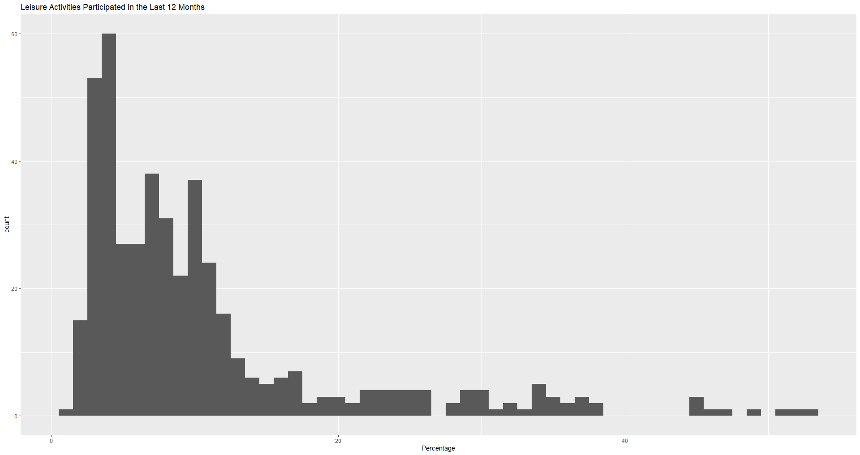
Histograms of Percentages by Frequency

Slide 17
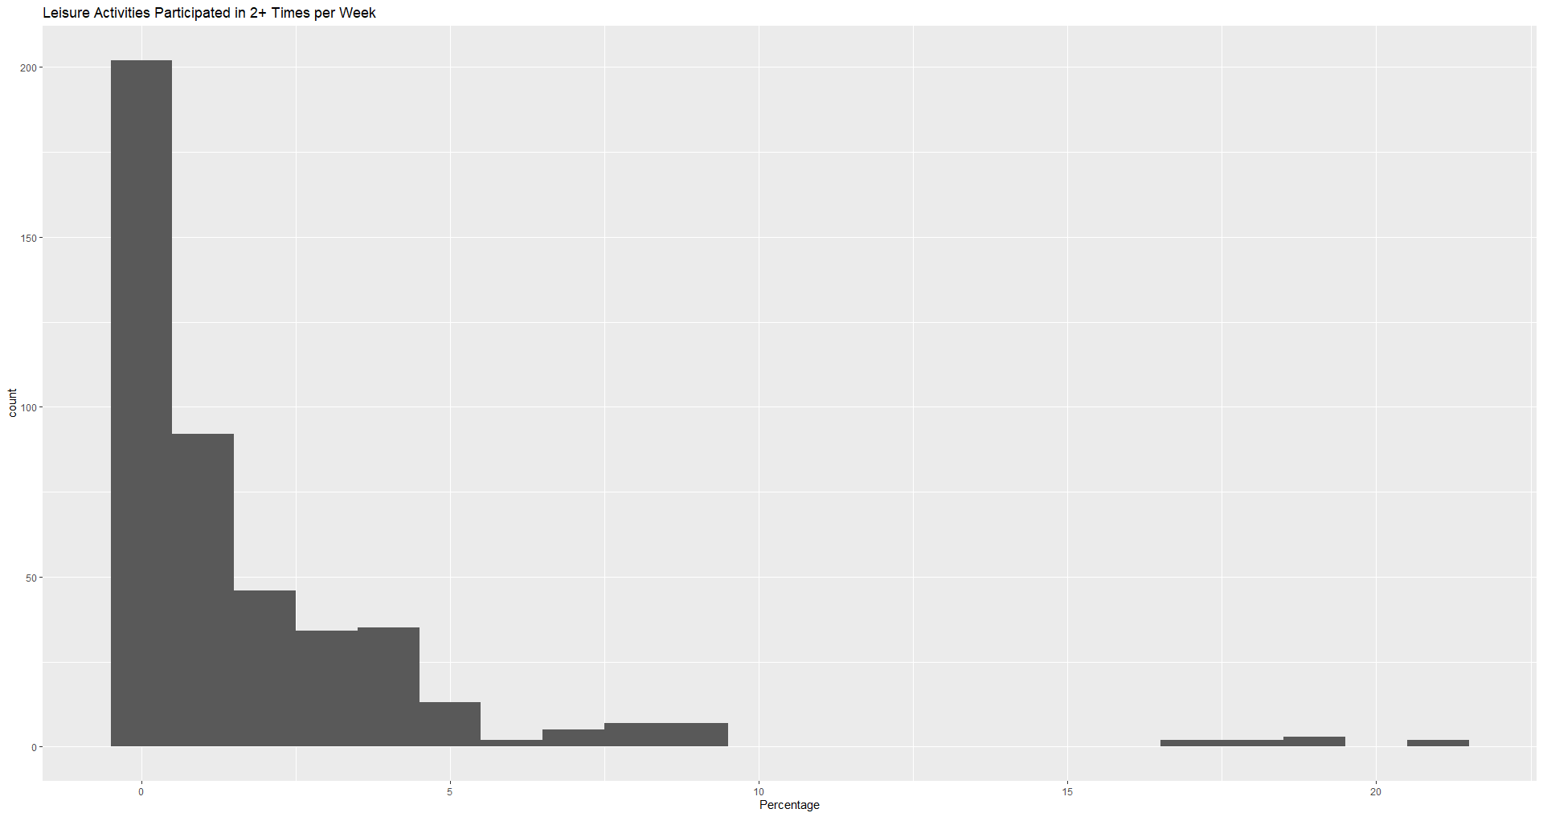

Slide 18
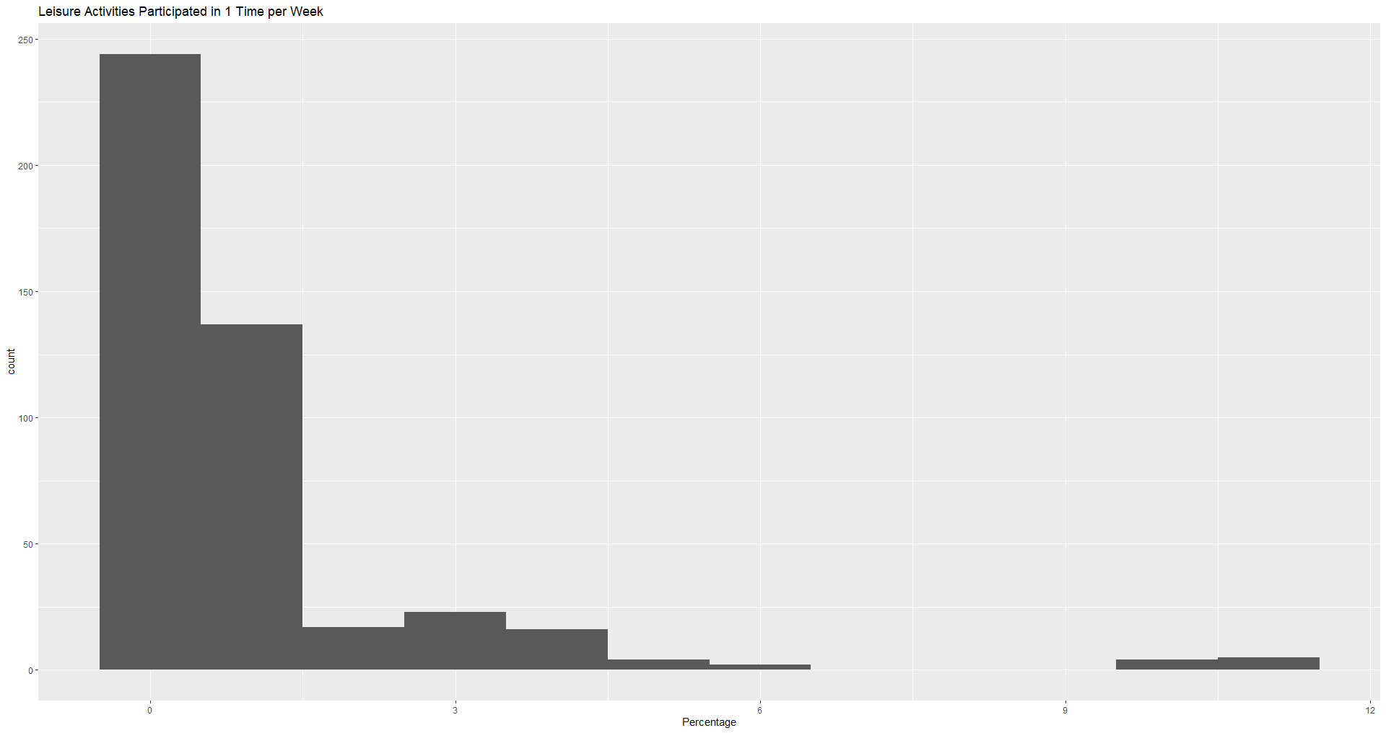

Slide 19
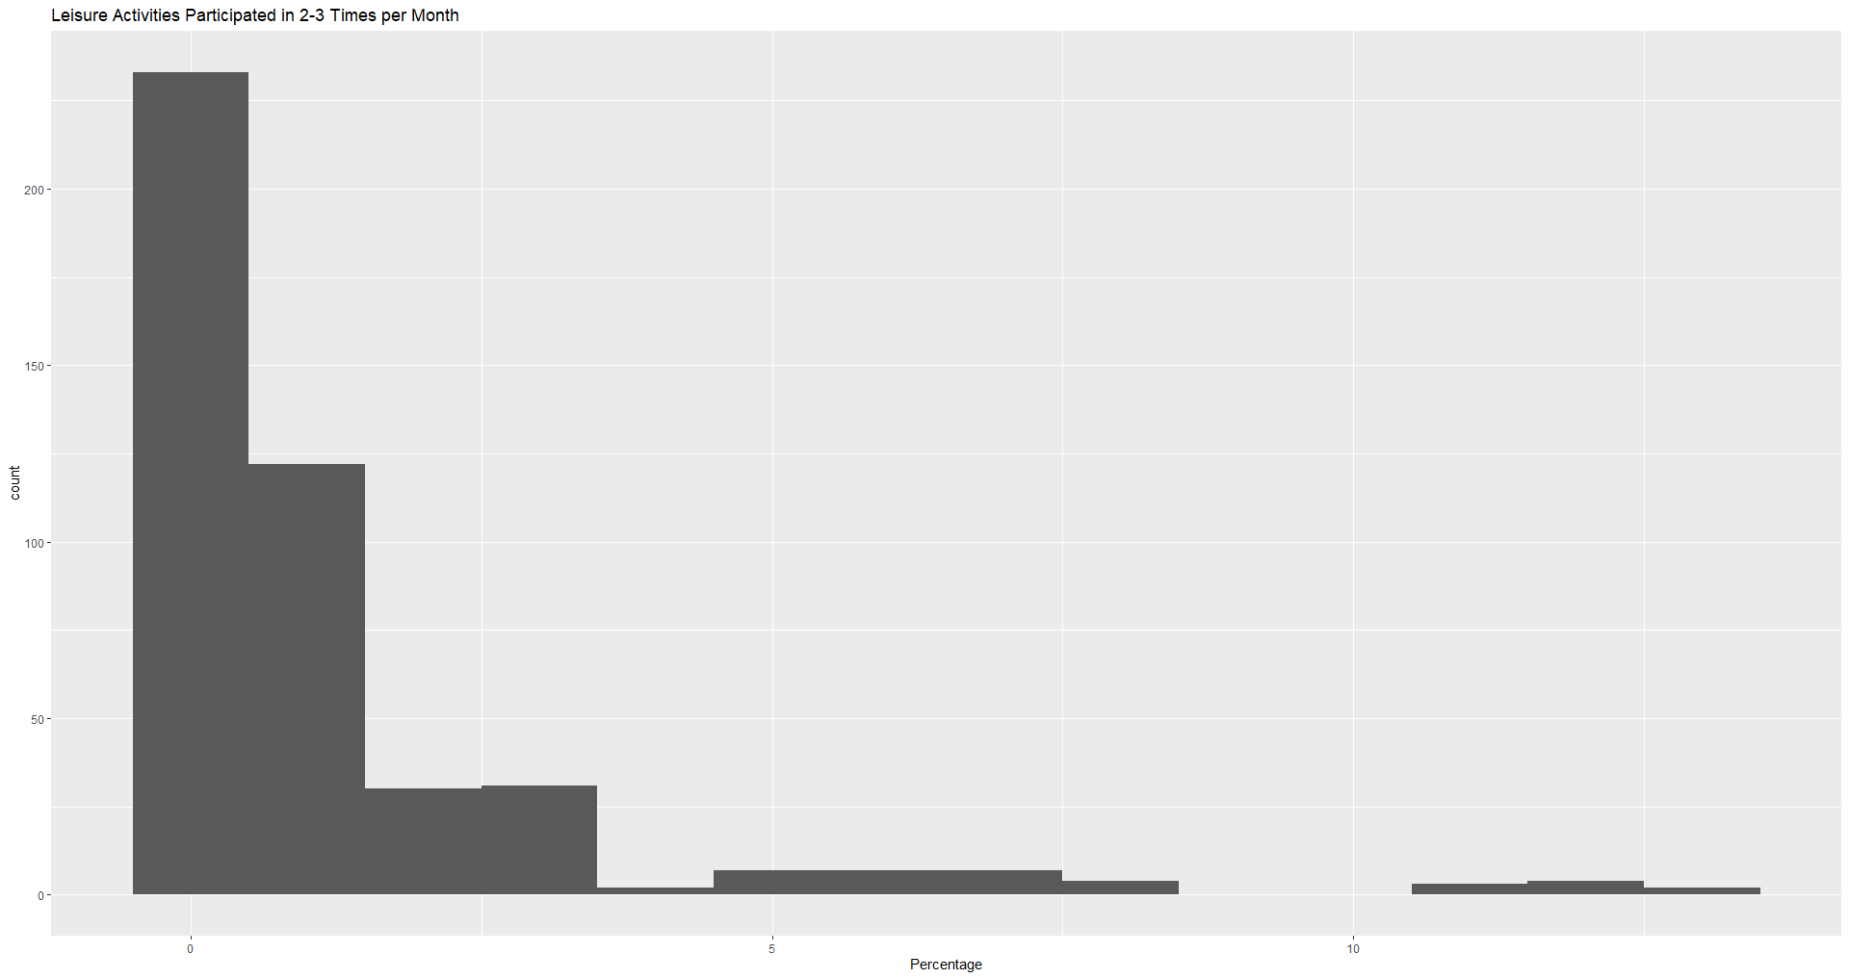

Slide 20
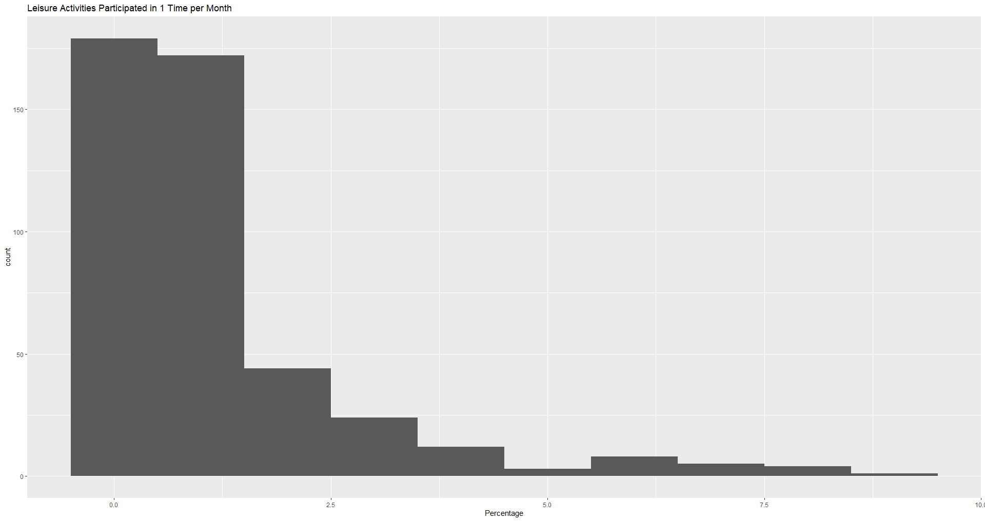

Slide 21
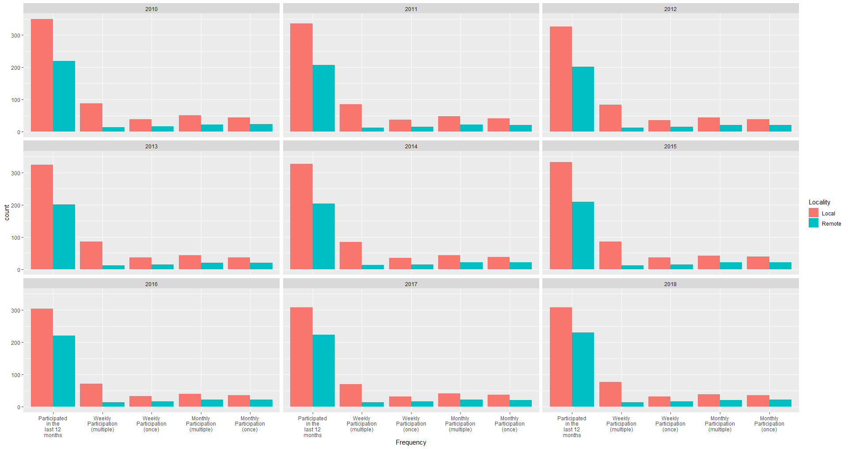
Total percentage of Local vs. Remote Locality by Frequency and Year (PMF)

Slide 22
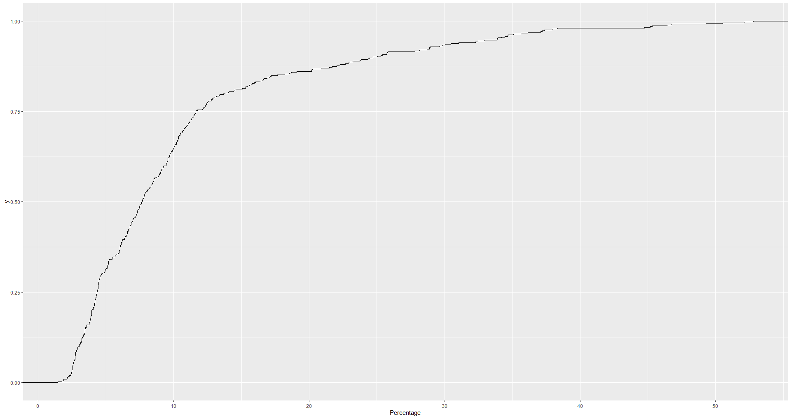
CDF of Percentage in Activities Participated in the Last 12 Months

Slide 23
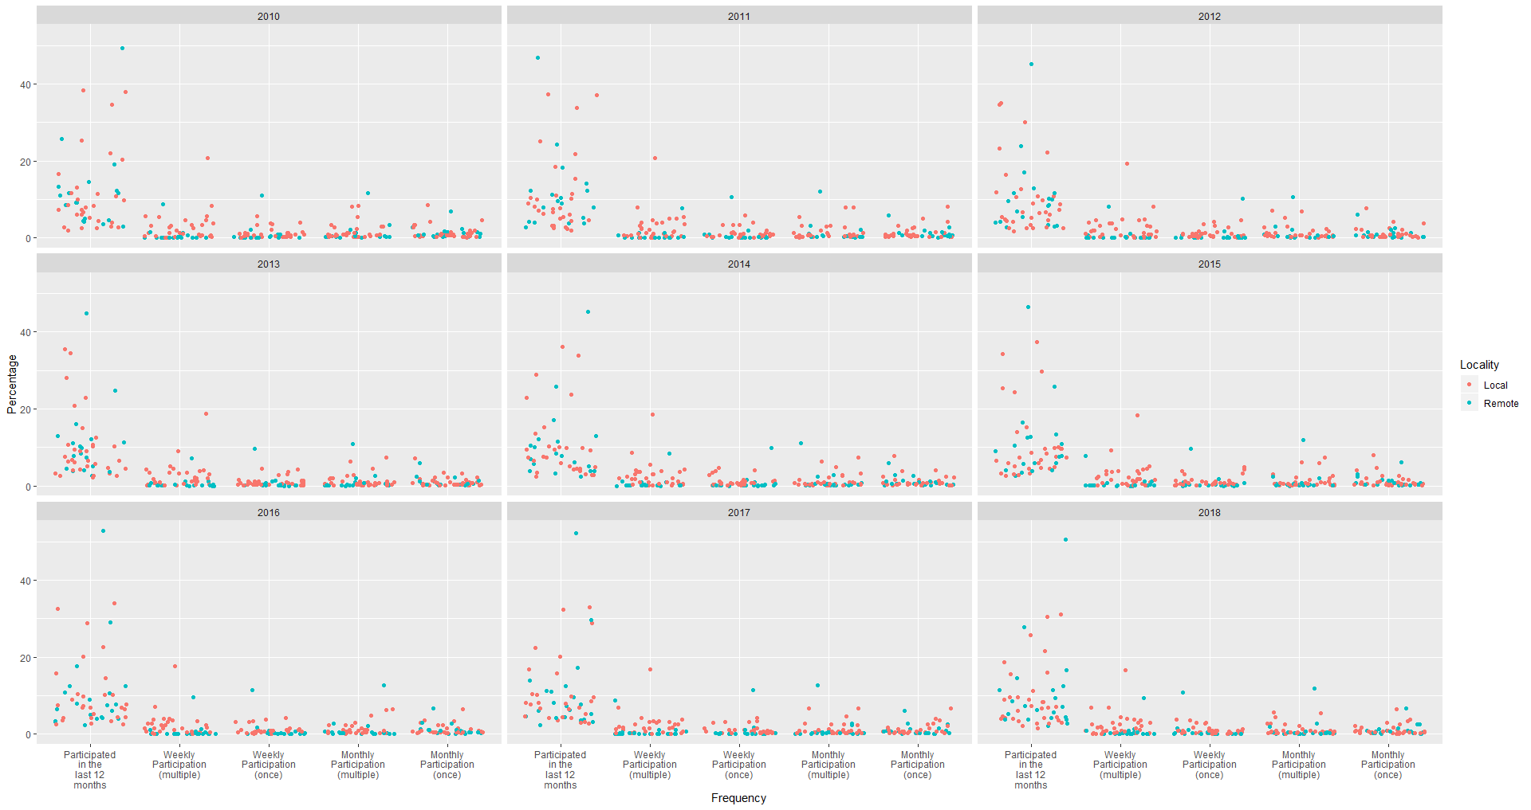
Scatter plot of Local vs. Remote Locality by Frequency and Year

Slide 24
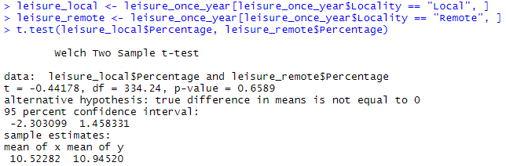
R code: Test of H₀
Result of statistical t-test: failure to reject H₀ due to p-value not falling within range of α = 0.05 for a two-tailed test – the mean of the percentage of adults participating in Local activities does not appear to differ in a statistically significant fashion from the means of the percentage of adults participating in Remote activities

Slide 25
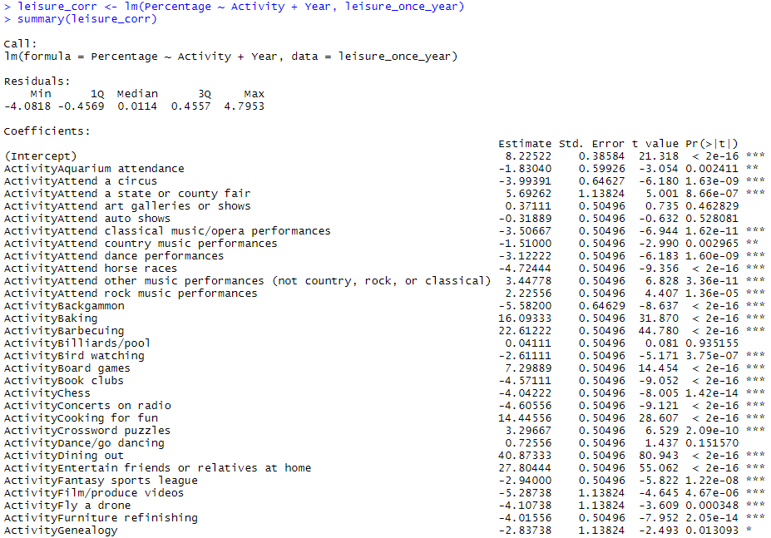
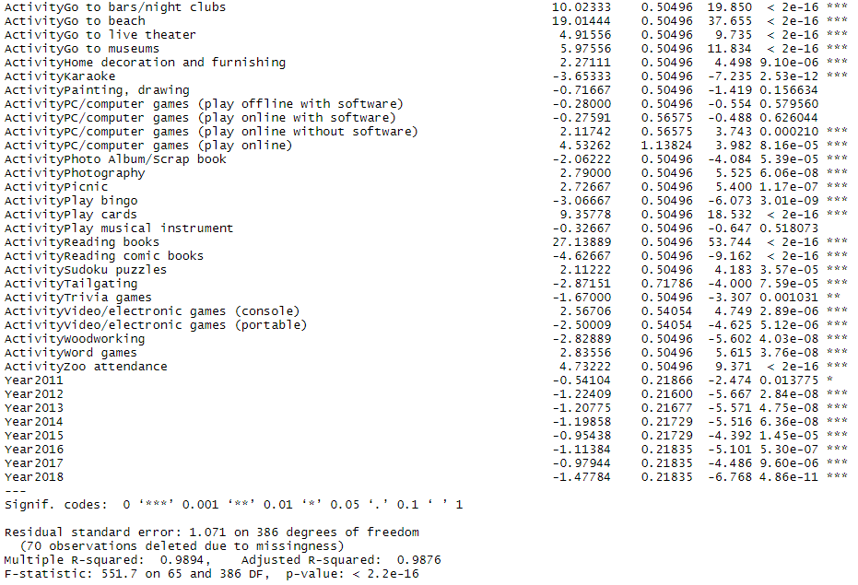
R code: Logistic Regression
The R code is treating the year 2010 (the first year in the data) and “Adult education courses” (the first activity in the sample) as the baseline values – the resulting coefficient of determination value (R-squared) is 0.9894, the square root of which is ≈0.9947 which implies a high correlation between the percentages and both activities and years together. Additionally, it is safe to assume that the activities themselves are producing causation for the percentage values, as are the years in situations where certain activities only appear in certain years

